Slide 1
Stories that Move
Lo-Fi Prototype

Slide 2
Select Your Story
Three Little Pigs (83%)
Aladdin
Magic School Bus
Download More Stories

Slide 3

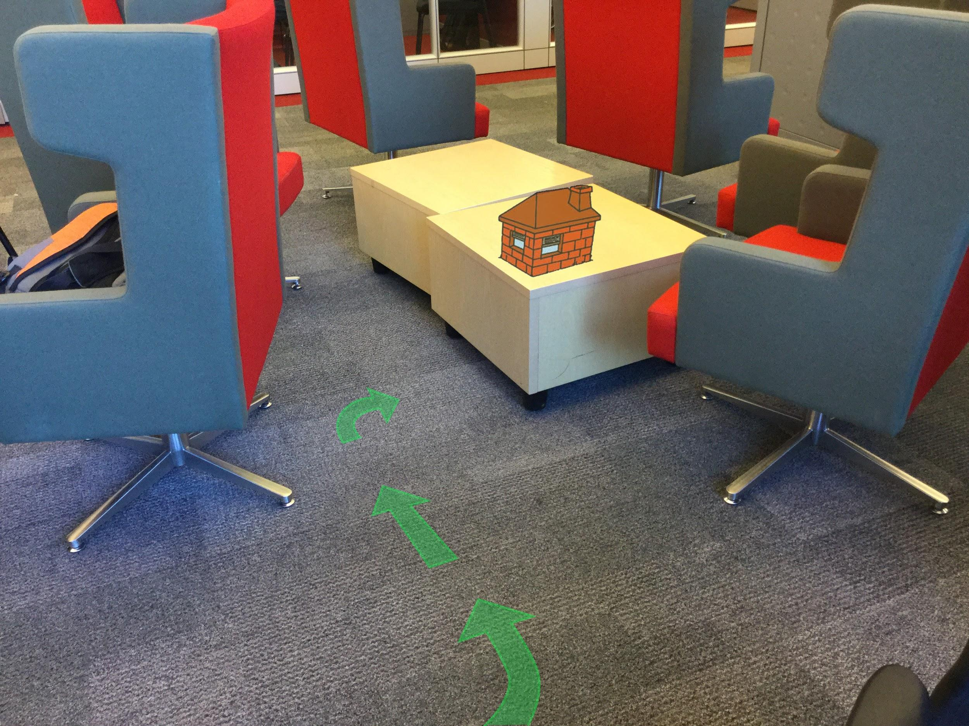


Story: The Three Little Pigs Strike Back
Progress: 83% ETA: 45 min
Yo Bros, sorry about your cribs. Let’s just chill at mine.
Lead the way to your oink-itechture!
Wheatie
Twiggy
Brick
Notes:
Current Story: Three Little Pigs
Task: Follow the directions to locate the house
Story so Far: Two houses blowed down, You want to see my sick crib? Follow the arrows

Slide 4
Paused
MENU
Resume
Settings
Help
Wheatie
Twiggy
Brick
Notes:
Menu Options

Slide 5
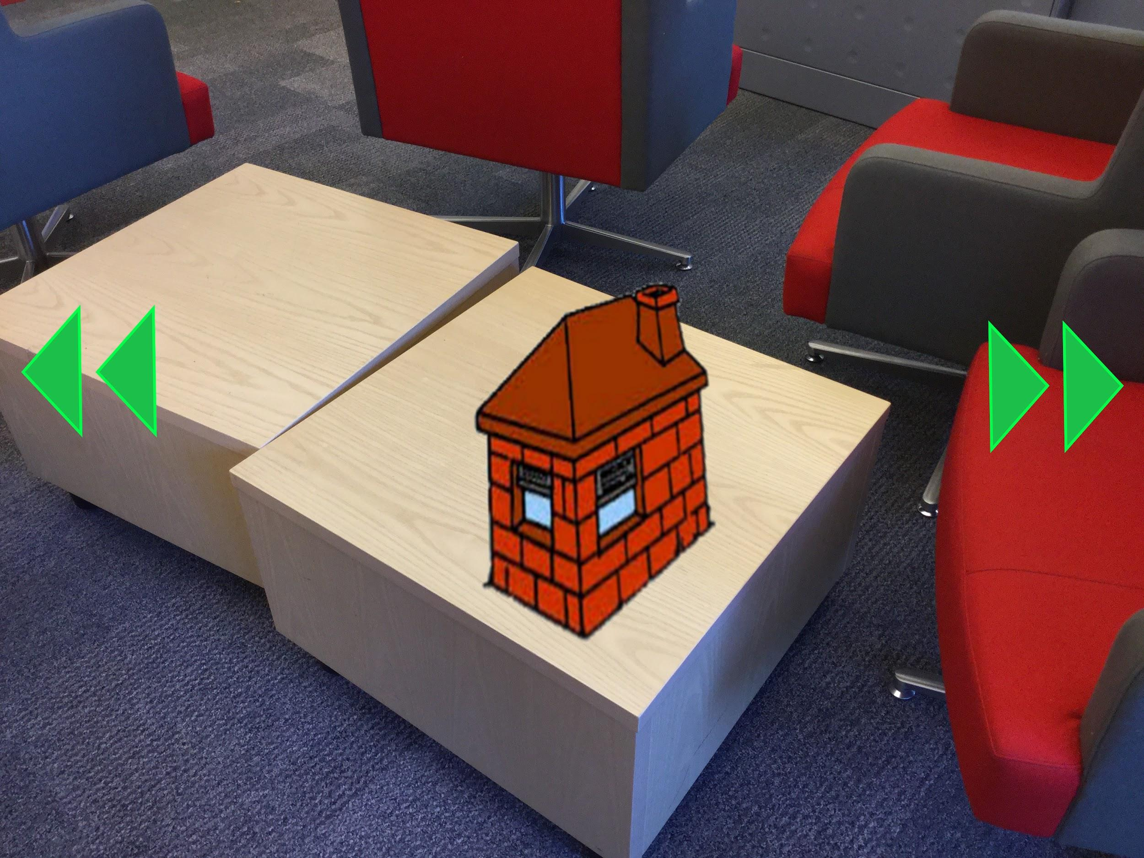
Story: The Three Little Pigs Strike Back
Progress: 85% ETA: 40 min
Nah, we should probably make sure wolf-bro isn’t around. Look around!
We’re here, just let us in already
Wheatie
Twiggy
Brick
Notes:
Task: Look around and scope out the surroundings
Story: Look around, make sure the wolf isn’t around before we enter. Look for him

Slide 6
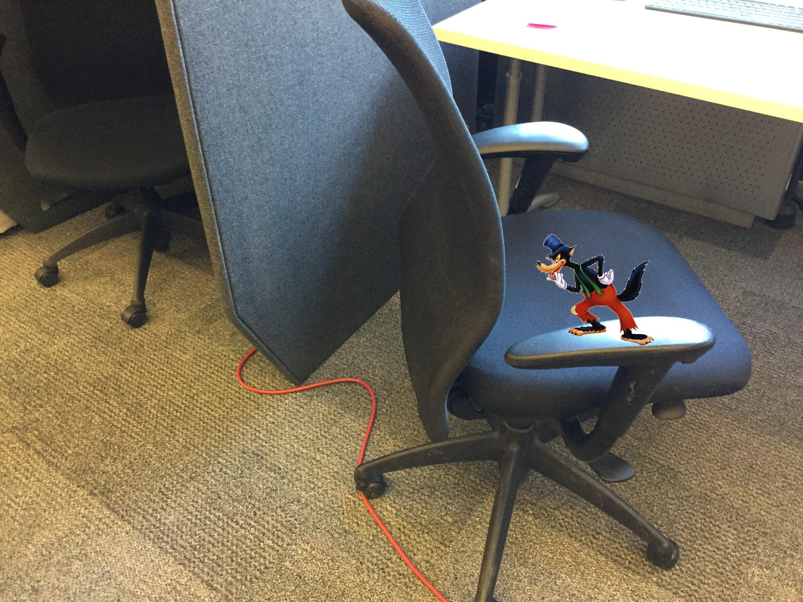
Story: The Three Little Pigs Strike Back
Progress: 88% ETA: 35 min
Oh Bacon...
THERE HE IS!
Get to the house!
Wheatie
Twiggy
Brick
Notes:
Task: Interact with the wolf before entering safely
Story: Uh oh, there he is! Stop him!

Slide 7
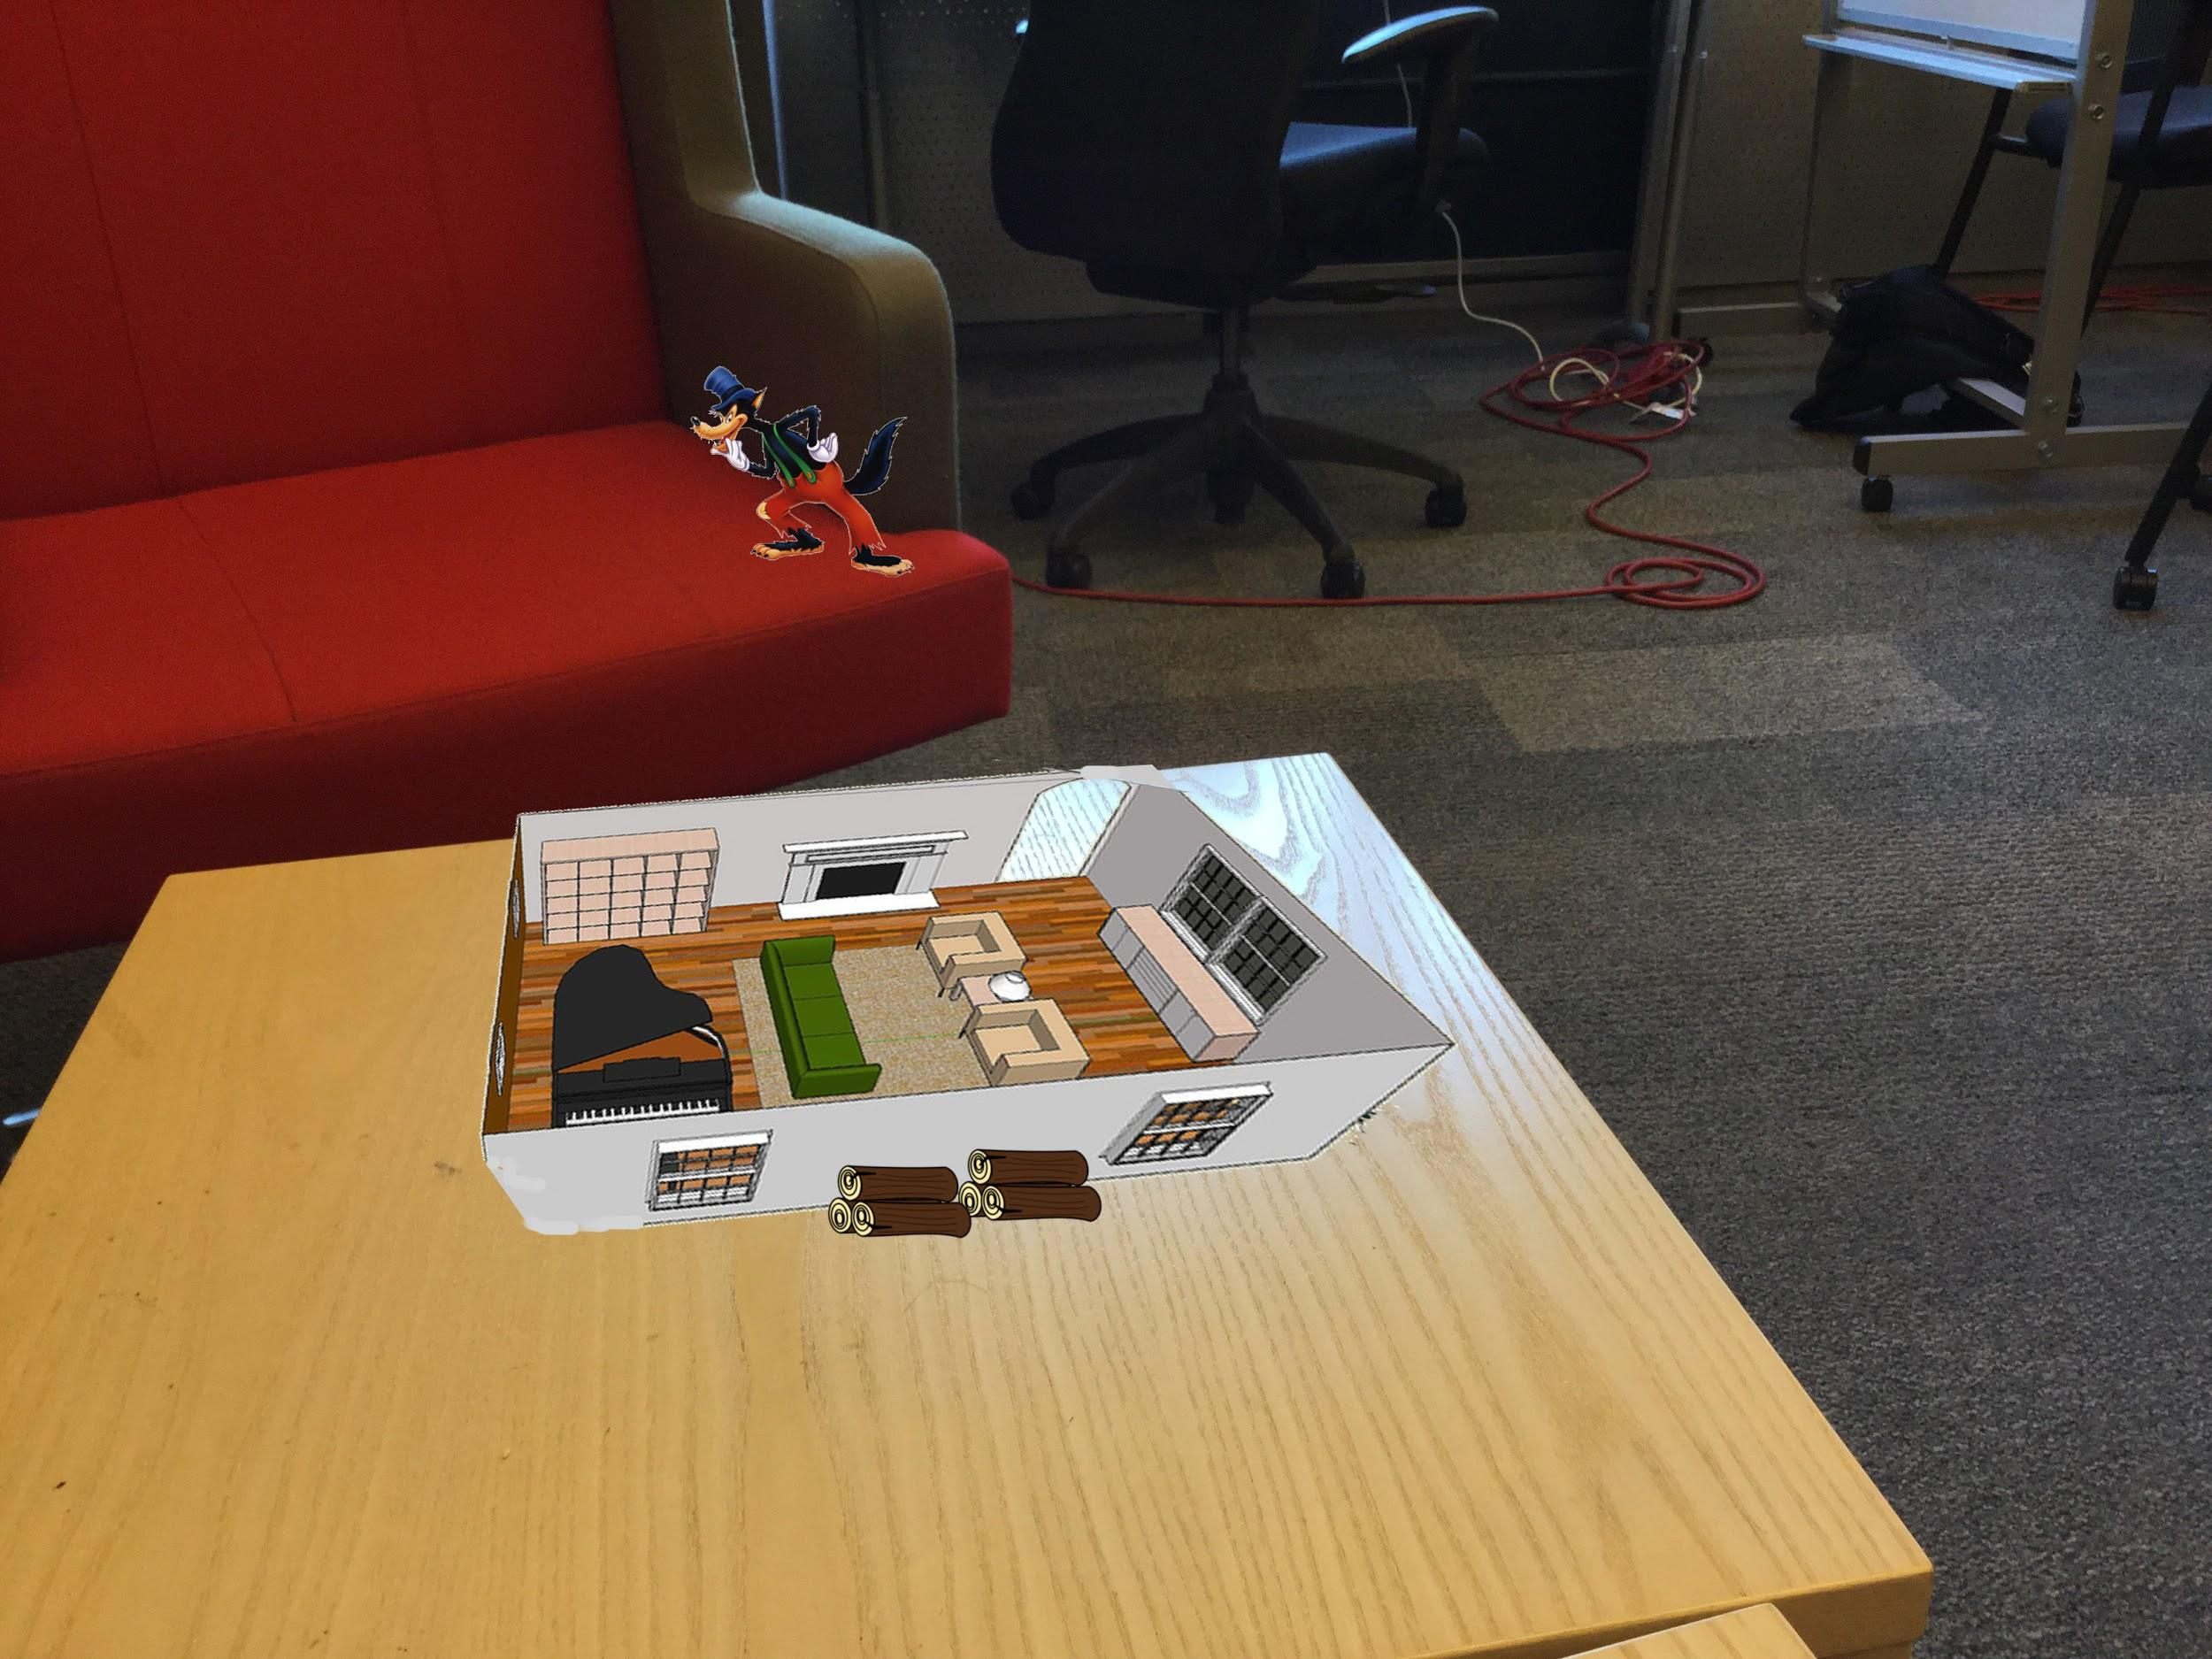
Story: The Three Little Pigs Strike Back
Progress: 90% ETA: 25 min
Quick, put the wood in the fireplace!
We need to light a fire!
Wheatie
Twiggy
Brick
Notes:
Task: Pick up the wood and put it in the house
Story: Start the fire!!

Slide 8
Story: The Three Little Pigs Strike Back
Progress: 95% ETA: 20 min
Nice job! Now he can’t get down the chimney.
Ah so warm
Wheatie
Twiggy
Brick
Notes:
Task: Success!

